Slide 1
Aws Lambda
OW

Slide 2
Definition
Amazon explains AWS Lambda (λ) as a ‘serverless’ compute service, meaning the developers, don’t have to worry about which AWS resources to launch, or how will they manage them, they just put the code on lambda and it runs, it’s that simple! It helps you to focus on core-competency i.e. App Building or the code.
AWS Lambda executes your backend code, by automatically managing the AWS resources. When we say ‘manage’, it includes launching or terminating instances, health checkups, auto-scaling, updating or patching new updates etc.

Slide 3
How it works?
The code that you want Lambda to run is known as a Lambda function. Now, as we know a function runs only when it is called, right? Here, Event Source is the entity which triggers a Lambda Function, and then the task is executed.
Different types of Event Source are available, based on that Lambda functions are called and perform the activity as per the flow
Serverless architecture is used in other way in Kubernetes using knative api

Slide 4
Example
Suppose you have an app for image uploading. Now when you upload an image, there are a lot of tasks involved before storing it, such as resizing, applying filters, compression etc.
So, this task of uploading of an image can be defined as an Event Source or the ‘trigger’ that will call the Lambda Function, and then all these tasks can be executed via the Lambda function.
In this example, a developer just has to define the event source and upload the code.

Slide 5
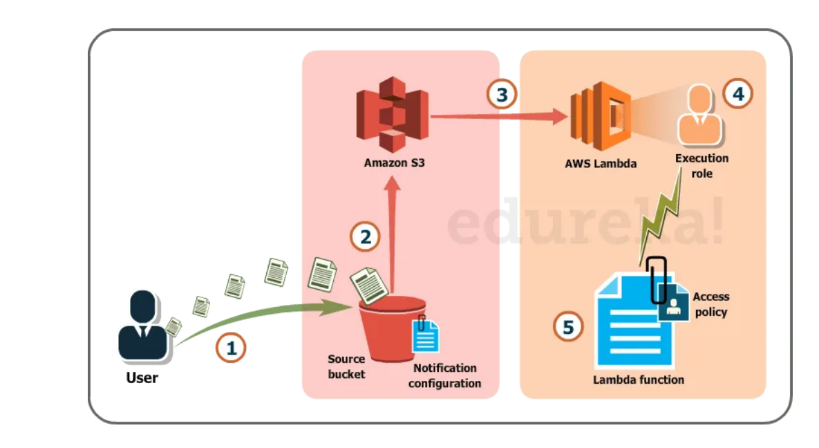
..

Slide 6
explanation
User uploads an image (object) to a source bucket in S3 which has notification attached to it, for Lambda.
The notification is read by S3 and it decides where to send that notification.
S3 sends the notification to Lambda, this notification acts as an invoke call of the lambda function.
Execution role in Lambda can be defined by using IAM (Identity and Access Management) to give access permission for the AWS resources, for this example here it would be S3.
Finally, it invokes the desired lambda function which works on the object which has been uploaded to the S3 bucket.

Slide 7
Challenges with Traditional approach
If you were to solve this scenario traditionally, along with development, you would have hired people for managing the following tasks:
Size, provision and scale up group of servers
Managing OS updates
Apply security patches and
Monitor all this infrastructure for performance and availability.

Slide 8
Pricing in AWS Lambda
Like most of the AWS services, AWS Lambda is also a pay per use service, meaning you only pay what you use, therefore you are charged on the following parameters
The number of requests that you make to your lambda function
The duration for which your code executes.
AWS Lambda counts a request each time it starts executing in response to an event source or invoke call, including test is invoked from the console. Let’s look at the prices now:
First 1 million requests, every month are for free.
0.20$ per million requests thereafter.

Slide 9
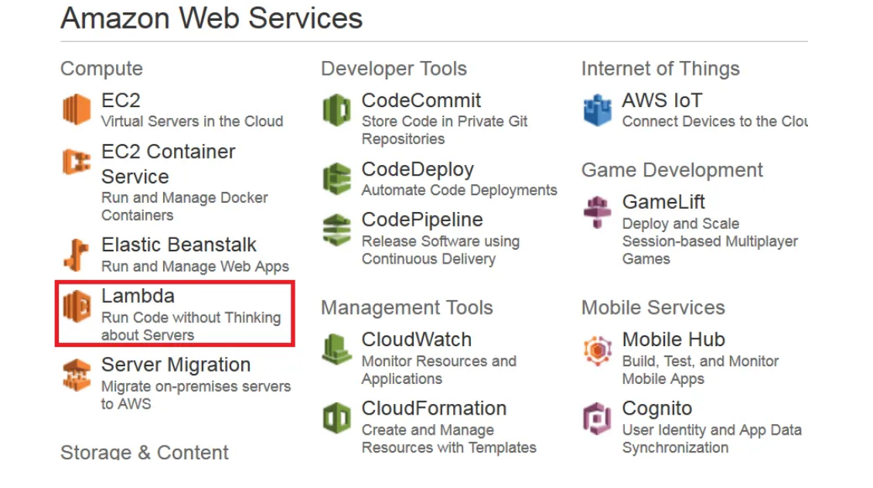
Aws console

Slide 10
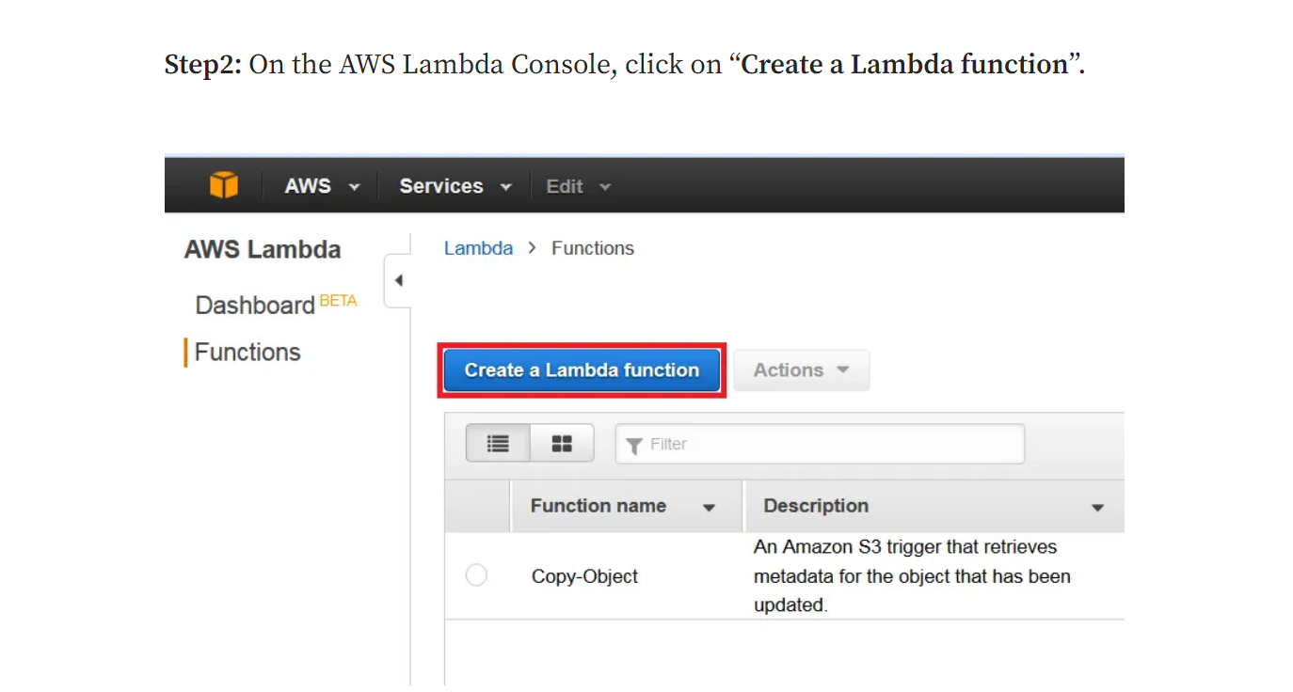
..

Slide 11
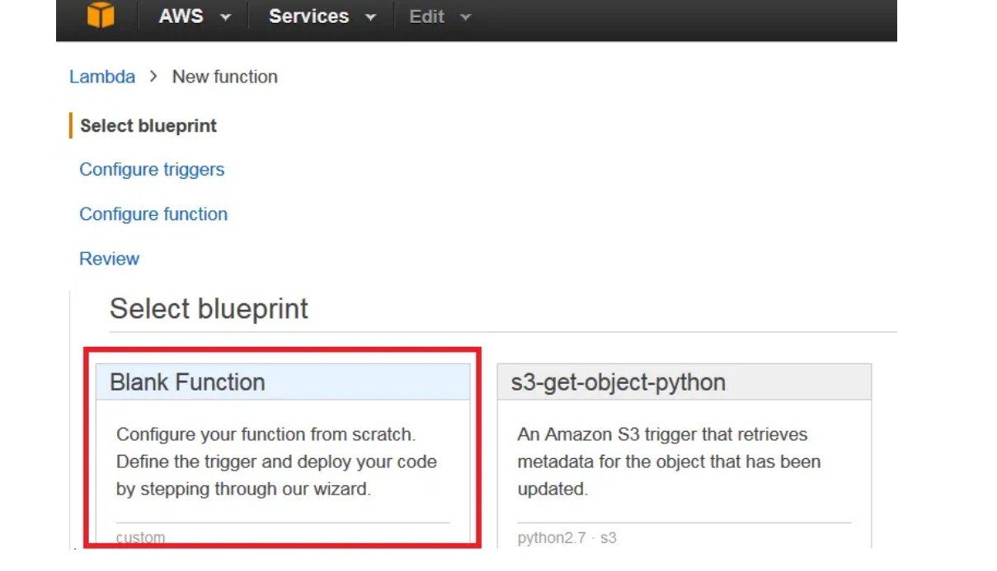
..

Slide 12
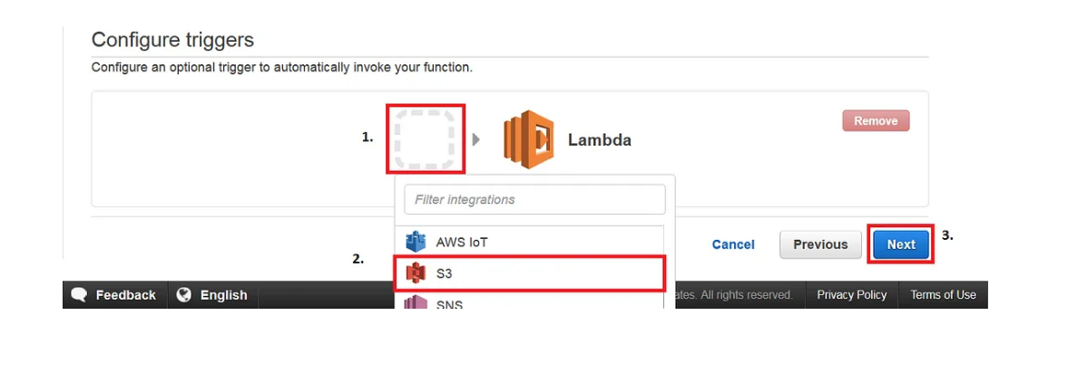
Configure Trigger

Slide 13
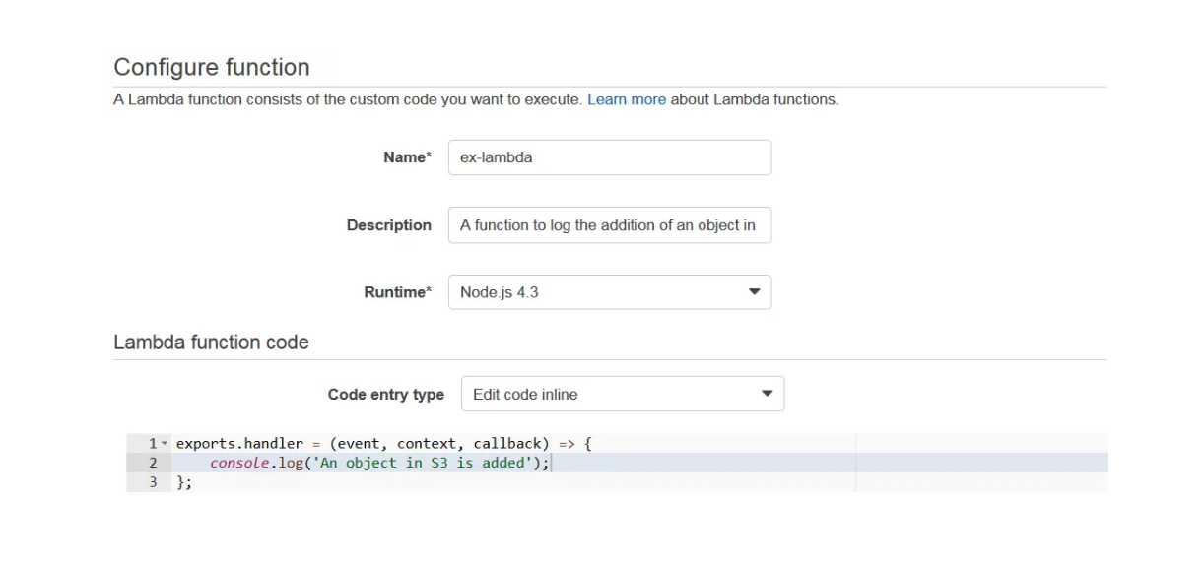
..

Slide 14
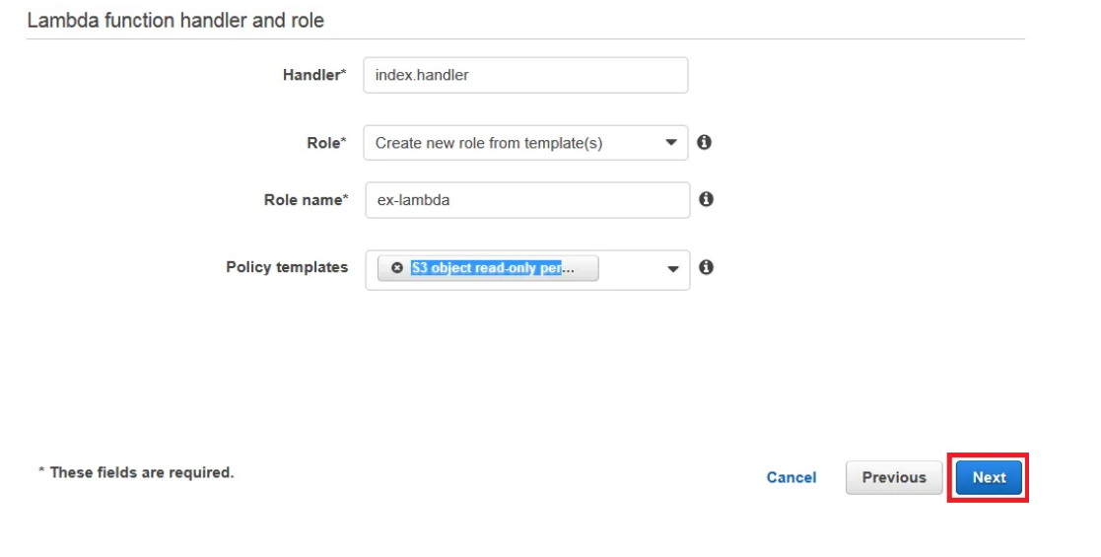

..

Slide 15
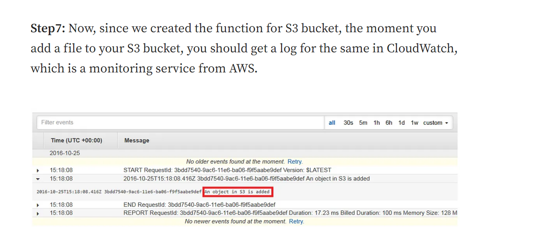
..

Slide 16
..
Lambda with s3
Lambda with api-gateway

